Slide 1

Making this resource work for you
Prior to teaching this lesson, please refer to the ‘Unit Overview and Planning Document’.
Further guidance on planning Science Mastery lessons can be found in the detailed planning guidance document.
Refer to the ‘notes’ section on each slide for useful information, including suggested expositions, pedagogical content knowledge, suggested questions, answers and more. Consider using presenter mode so you can see this guidance throughout the lesson.
The introduction slides can be adapted to suit your teaching style and the needs of your class.
Before the lesson, adapt the fix-it slide to address any misconceptions identified in the previous lesson’s exit ticket.
Choose from the suggested activities to suit your class. The intention is not that you complete all of these, but that you select those which ones are most appropriate for your students. It may be appropriate to further adapt activities for your students.
These lessons are designed to occupy approximately 1 hour. To adapt for a shorter or longer lesson duration we advise you to adapt the activity section accordingly.
Please consider using the final slide to send feedback about this lesson or examples of PowerPoints that you have adapted to our design team. Your feedback is used to improve Science Mastery for all of our teachers and students. We appreciate all suggestions and comments.
Thank you for reading!
The Science Mastery Team

Slide 2

Resultant Vectors
Answer the following questions:
State the definition of a scalar quantity.
State the definition of a vector quantity.
Classify force as a scalar or a vector quantity.
State the definition of resultant force.
Sketch two lines that are perpendicular to each other.
A quantity that has size/magnitude only.
A quantity that has size/magnitude and direction.
Vector
The net force or the overall effect of all the forces acting on an object.
Notes:
Foundation question: 2 boys both push a trolley to the left with a force of 80 N each. What is the resultant force?
Stretch question: Explain the difference between speed and velocity and how you could calculate both.
Answers:
Foundation: Forces are acting in the same direction so they are added together. Resultant force = 80 N + 80 N = 160 N left.
Stretch: Speed is how much distance is covered in a given time, velocity is speed in a particular direction. Speed is calculated by using the distance travelled divided by the time taken. Velocity is calculated by using the displacement of the object divided by the time taken

Slide 3
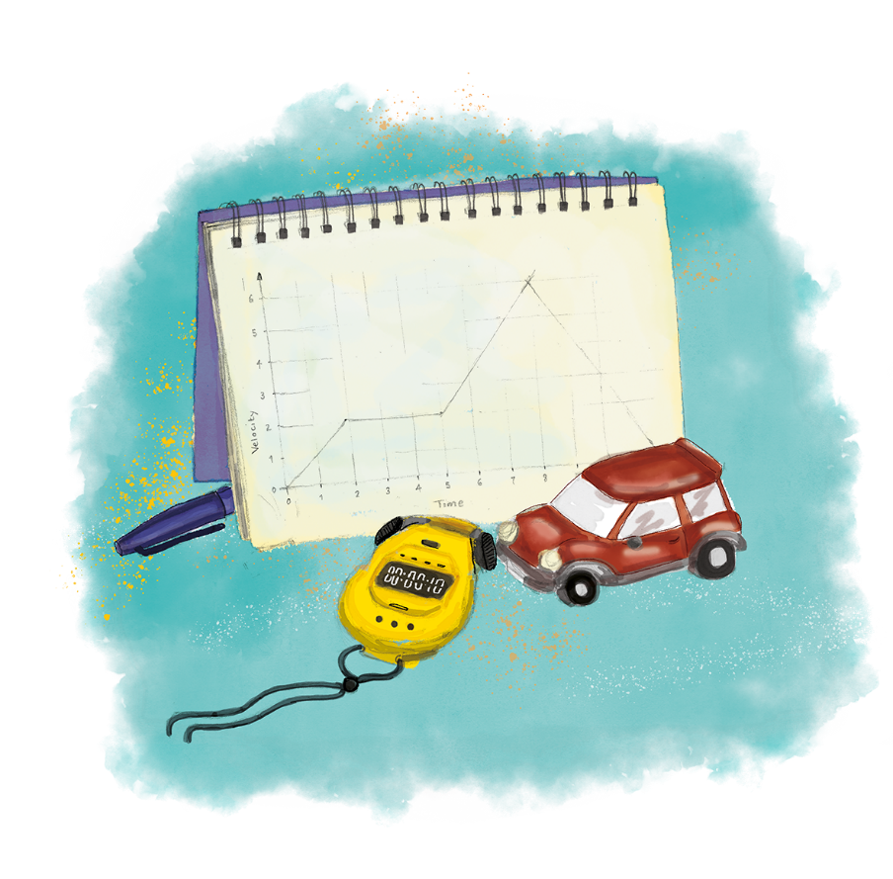


P3.1.3
20/03/2025
Resultant Vectors
P3.1.1 Prior Knowledge Review
P3.1.2 Scalars and Vectors
P3.1.3 Resultant Vectors
P3.1.4 Resolving Vectors
P3.1.5 Newton's Third Law
P3.1.6 Newton's First Law
P3.1.7 Acceleration
P3.1.8 Acceleration Investigation
Maths in Science Lesson 17
P3.1.9 Velocity-Time Graphs
P3.1.10 Velocity-Time Graphs 2
P3.1.11 Acceleration Problems
Notes:
In the last lesson pupils looked at the difference between scalar and vector quantities. In this lesson they will continue looking at vectors by looking at how to calculate and resolve resultant vectors. From P1.1 they should know how to calculate resultant force, when forces are acting in the same and in opposite directions. In this lesson pupils will look at how to determine resultant vectors when they are acting perpendicular to each other using scale drawings. In the following lesson they will look at how to resolve resultant vectors into their horizontal and vertical components, also using scale drawings. Calculations require solid understanding of Pythagoras’s theorem and trigonometric ratios, which most pupils will not meet until later in Y9. Determining resultant by calculation and resolving into components can be introduced in P4.1 as a recap to forces and motion and the difference between scalar and vector quantities.
Hook:
Put a free-body force diagram on the board of a horizontal force and a vertical force acting on the same object (e.g. a box being lifted diagonally). Ask pupils to explain how they could work out the resultant force acting on the object. For the sake of simplicity, weight can be ignored for this, unless you have a very able class who could resolve the vertical components first).

Slide 4

Following this lesson, students will be able to:
Define resultant vectors.
Use scale drawings to determine resultant vectors.
Key Words:
resultant
vector
scale
horizontal
vertical

Slide 5
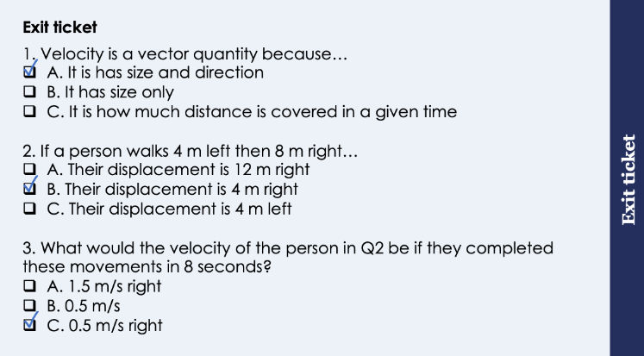
This is the fix-it portion of the lesson
The fix-it is an opportunity to respond to gaps in knowledge, especially those identified by the previous lesson’s exit ticket.
The teacher should customise this slide as needed, to facilitate
reteach, explanation, demonstration or modelling of ideas and concepts that students have not yet grasped or have misunderstood.
practise answering specific questions or of key skills.
redrafting or improving previous work.
Notes:
Suggested Guidance from previous exit ticket:
Q1. Answer: A
If students answer B they have confused scalar and vector quantities and if students answer C they have confused speed and velocity. To fix-it, practice speed and velocity calculations and explain in each case why they are scalars and vectors.
Q2. Answer: B
If students answer A they have calculated distance rather than displacement. If students answer C they have subtracted but their direction is incorrect. To fix-it, practice distance vs displacement calculations from described journeys.
Q3. Answer: C
If students answer A they calculated the speed rather than the velocity. If students answer B they have correctly calculated velocity but not remembered it is a vector quantity so must have a unit. To fix-it, practice questions calculating speed vs velocity and explain the difference between them.

Slide 6

Think outside the box!
What would happen if a force of 20 N pulled an object to the left and a force of 5 N pushed an object to the right?
How could these forces be represented?
What would the overall effect of these forces be on the motion of the object?
Are these forces balanced or unbalanced?
How could these forces be balanced?
Notes:
This can be used as an opportunity to check that pupils understand the fundamental idea of resultant force before moving on to perpendicular vector combinations.
Listen out for pupils explaining how to calculate the resultant force and using the correct definition of resultant force, as well as remembering to include a direction because it is a vector quantity.
Pupils can draw a free body force diagram to help them visualise the scenario.
Resultant force = 20 N left - 5 N right = 15 N left
These forces are unbalanced, they are not equal and opposite.
They could be balanced by adding a 15 N force towards the right.
The object’s motion would depend on its original motion (which will be revisited in L6 of this unit).
If it was initially stationary it would accelerate towards the left.
If it was initially moving towards the left it would accelerate towards the left.
It if was initially moving towards the right it would accelerate towards the left, meaning that it would slow down.
Suggested guidance:
Talk tasks can be used in a variety of ways to suit the particular needs of the students you are teaching. Through exchanging views with others, students develop their understanding of the science beyond what could be achieved individually.
Science classrooms that successfully integrate talk have the following features:
Science talk is a regular feature of lessons and is woven into classroom activities.
Students are paired or grouped strategically by the teacher to ensure productive interaction. This might take into consideration the students’ proficiency of the English language, how encouraging they might be to peers and their attainment in the topic. It’s a good idea to consider these pairings in the class seating plan.
Students are encouraged and supported to talk, but are not forced to talk.
The teacher should take on the role of a facilitator, engaging with conversations where necessary and encouraging or steering the conversation where needed.
Students are encouraged to use the language they have to express their ideas (e.g., everyday language, imperfect English, native language), but also to incorporate science specific terminology where this is more accurate or has been taught.
6. Scientifically inaccurate ideas are not dismissed by the partner or teacher; open discussion and further investigation are relied on to help students construct ideas that support them to progress in their scientific understanding.
7. Guidelines for behaviour during talk tasks are explicit and frequently reviewed. Rules for students might be:
Listen carefully to your partner
Take turns talking.
Speak one at a time, without interrupting.
Politely agree or disagree and explain why.
Politely point out if your partner has used a scientific word incorrectly, if they have explained the science incorrectly, or if there is a more accurate way to describe something.
If confused, ask questions.
Stay focused on the discussion topic.
Respond to one another.

Slide 7
Resultant Vectors
A resultant vector is the combination of two (or more) single vectors.
Resultant force is an example of a resultant vector.
Other vectors can combined to make a resultant, including displacement and velocity.
20 N
5 N
Resultant force = 15 N left
200 m
350 m
Resultant displacement = 150 m right
6 m/s
Resultant velocity = 8 m/s left
2 m/s
Notes:
Exposition type: Explanation
Suggested exposition:
We know from previous units that a resultant force is the net force acting on an object, or the overall effect of all the forces acting on an object. The same principle can be applied to other vectors as well - a resultant vector is the combination of two (or more) single vectors. This can also be described as a single vector that has the same effect as all the other vectors combined. Resultant force is just one example of a resultant vector, but displacements can also form a resultant vector, as can velocities. Vector diagrams are drawn in the same way as free-body force diagrams, with an arrow in the direction of action and the length of the arrow represents the magnitude (size) of the vector.
In the same way we calculate resultant force, we can calculate resultant vectors. Remember that vectors are quantities with size and direction so we have to take both of these into account. Vectors acting in opposite directions from each other are subtracted and vectors acting in the same direction are added together to give the resultant vector.
For example - look at this object that has 20 N of force pulling it to the left and 5 N of force pulling it to the right. We can see these forces are acting in opposite directions so we subtract the smaller from the larger and this gives us a resultant force of 15 N left.
We can use exactly the same process for other vectors, such as displacement. In this case an object has moved 200 m left and then 350 m right. These displacements are in opposite directions so they are subtracted, giving a resultant displacement of 150 m right. Our resultant displacement is a vector so needs to be described with a direction as well.
If we have a cyclist travelling with a velocity of 6 m/s left but he has a tailwind (acting in the same direction, the wind is behind him) with a velocity of 2 m/s left, his resultant velocity would be the sum of these as they are acting in the same direction, giving a resultant velocity of 8 m/s left.

Slide 8
What happens when vectors are not acting in a straight line?
What would happen if a force of 150 N pulled an object to the right and a force of 100 N pulled an object upwards?
Which direction would the resultant force be acting in?
How big would the resultant force be?
100 N
150 N
Notes:
Pupils are not expected to be able to explain how to determine the resultant but they should be able to explain that the resultant force would act somewhere in the middle of these.
Stretch:
Why would the resultant force not be exactly in between (at 45º) the two forces?
Because the forces are different sizes so there is more force pulling right than there is pulling upwards.
When would the resultant force be exactly in between?
When the forces are the same magnitude.
Suggested guidance:
Talk tasks can be used in a variety of ways to suit the particular needs of the students you are teaching. Through exchanging views with others, students develop their understanding of the science beyond what could be achieved individually.
Science classrooms that successfully integrate talk have the following features:
Science talk is a regular feature of lessons and is woven into classroom activities.
Students are paired or grouped strategically by the teacher to ensure productive interaction. This might take into consideration the students’ proficiency of the English language, how encouraging they might be to peers and their attainment in the topic. It’s a good idea to consider these pairings in the class seating plan.
Students are encouraged and supported to talk, but are not forced to talk.
The teacher should take on the role of a facilitator, engaging with conversations where necessary and encouraging or steering the conversation where needed.
Students are encouraged to use the language they have to express their ideas (e.g., everyday language, imperfect English, native language), but also to incorporate science specific terminology where this is more accurate or has been taught.
6. Scientifically inaccurate ideas are not dismissed by the partner or teacher; open discussion and further investigation are relied on to help students construct ideas that support them to progress in their scientific understanding.
7. Guidelines for behaviour during talk tasks are explicit and frequently reviewed. Rules for students might be:
Listen carefully to your partner
Take turns talking.
Speak one at a time, without interrupting.
Politely agree or disagree and explain why.
Politely point out if your partner has used a scientific word incorrectly, if they have explained the science incorrectly, or if there is a more accurate way to describe something.
If confused, ask questions.
Stay focused on the discussion topic.
Respond to one another.

Slide 9
Vector Diagrams
Higher Tier only
The resultant of two (or more) vectors acting perpendicular to each other can be determined using a scale drawing.
Example: What is the resultant force when a force of 8N right and 10N upwards.
Choose a suitable scale to use for the scale drawing (e.g. 1 N = 1 cm)
Draw the first vector using your scale and a ruler
At the end of your first vector, draw the second vector using the same scale
Draw line from the point of origin to the end of the 2nd vector - this is the resultant vector
Measure the length of the resultant and use your scale to determine its real magnitude
Draw on the angle between the first vector and the resultant vector. Measure the angle using a protractor and label it on the diagram.
Resultant
12.8 cm = 12.8 N
10 N
51º
8 N
Notes:
Exposition type: demonstration
Ideally you should draw this on a whiteboard live so that pupils can follow along with the steps.
Suggested exposition:
We know that the resultant of two vectors acting perpendicular (at 90º) to each other will be somewhere in the middle of the single vectors. But where exactly? We can determine this by using a scale drawing to measure the length of our resultant and its direction. Drawing vectors to find the resultant in a diagram is called a vector diagram. Next year we will also learn to calculate these resultants using Pythagoras and trigonometry but for now we will just be using scale drawings.
We use the term tip to describe the pointed end of an arrow line and the tail to describe the other end.
Step 1: Choose a suitable scale to use for the scale drawing. In this example we have two vectors, 8 N and 10 N, so we can use a scale of 1 N represents 1 cm. We could use 2 N = 1 cm, but this could make our drawing much smaller.
Step 2: Draw the first vector using your scale in pencil, using a ruler. In this case 8 N will be represented by a line of 8 cm. Make sure that the whole arrow is in this 8 cm line - it should not be an 8 cm line with an arrow then added on the end as this would not represent the correct value.
Step 3: Draw the second vector using the same scale and also using a ruler and pencil. It should be perpendicular (at right angles) to the first vector. In this case that would be a 10 cm line going upward from the 8 cm line.
Step 4: Draw another dotted line from the point of origin to the opposite corner - this is your resultant vector.
Step 5: Measure the length of this resultant and use your scale to determine its real magnitude. In this case the line of the resultant was 12.8 cm, meaning that the actual size of the resultant would be 12.8 N.
Step 6: Nearly done! Because we are looking at resultant vectors, our answer can only be fully described with a direction too. Our direction is an angle so we measure the angle between the first vector and the resultant using a protractor. This gives us the direction that the resultant is acting in, in this case 51º from the horizontal line so we can describe it as 51º from horizontal.
Finally we can write our answer out in full. The resultant vector (in this case force) is 12.8 N at 51º from horizontal.
The direction can also be written as a bearing but an angle is also fine. This would be on a bearing of 039º.
What happens if we measured the angle on the other side?
This would be equally as correct! In each of these scenarios there will always be two possible answers depending on which angle we choose to measure and neither is more correct than the other. It would still give us the same length for the resultant vector, the only thing that would be different would be the angle. In this case if we used the vertical vector first, the angle of our resultant would be 39º rather than 51º.
What do you notice about these numbers?
51º and 39º add up to 90º because the vectors are acting at 90º to each other!
Shown this way to illustrate the fact that there will be different answers for the direction of the resultant force, although the magnitude will be the same.
Note: in exam questions generally 2-3º leeway is given for angles, and 0.1-0.2 cm for measurements.

Slide 10
Resultant Vectors
Higher Tier only
Use a scale drawing to determine the resultant vector.
A person walks 5 km East then 15 km South.
72º
1 km = 1 cm
Notes:
Exposition type: demonstration
Ideally get pupils to draw along in their books with each step so they can practice slowly before they try it independently.
Suggested exposition:
Let’s follow the steps and determine the resultant vector in this case.
What was the first step?
Choose a suitable scale.
Sometimes we can use graph paper to help make sure our lines are actually perpendicular. In this case we can use a simple scale of 1 km = 1 cm. We could use 5 km = 1 cm but this would make our diagram very small again and the smaller the diagram the less accurate our measurement of our resultant line will be.
Then what?
Use the scale to draw the first vector.
In this case we can just use the order that the vectors are given, but it would be equally correct in either order. Our line here would be 5 cm if we were using the scale 1 km = 1 cm.
Then what?
Draw the next vector using the same scale.
In this case our line would be 15 cm downwards. It is worth checking at the beginning before you start drawing the directions you will be using - this will help you work out if you should start drawing at the top/bottom/left/right of your page!
What happens next?
Where does the resultant vector go from?
From the point of origin to the opposite corner of the rectangle.
Then what?
Measure the length of this line (the resultant, which is the diagonal line) and use the scale to determine the actual magnitude of the resultant.
This is where you can check that pupils have drawn their lines correctly.
It should be 15.8 cm but a measurement between 15.7-15.9 cm is acceptable.
What does this measurement mean?
We can use our scale to determine the actual value of the resultant. 1 cm = 1 km, so 15.8 cm = 15.8 km.
The resultant will always be bigger than either of the single vectors because it is the hypotenuse (longest side) of the triangle.
Are we finished?
No. Resultant vectors need to have a direction as well so we need to find the angle of the resultant.
We measure the angle between the first vector and the resultant and this is the angle we use to describe the direction of the resultant. Remember there will be two possible answers here, depending on which way round we drew our single vectors.
In this case (drawing East first) gives us an angle of 72º. An answer of between 71-73º would be acceptable here. In this case we are using compass directions (North/South/East/West) so we cannot say horizontal or vertical. In this case we can describe the angle as 72º South of East or 72º from East.
If we drew South first the angle we measured would be 18º and it would be described as 18º East from South or 18º from South.
What is the other way we can describe direction?
As a bearing. In this case the angle is downwards/South of East so the bearing would be 90º + 72º = 162º.
Describing an answer as a bearing is not essential but we must include a direction as it is a resultant vector.
Last thing to do is to write the final answer with magnitude and direction: the resultant vector (displacement) is 15.8 km at 72º.

Slide 11
Resultant Vectors
Higher Tier only
Use a scale drawing to determine the resultant vector.
An object has a weight of 500 N, and is pulled to the left with a force of 300 N and to the right with a force of 200 N.
300 N
200 N
100 N
50 N = 1 cm
Notes:
Exposition type: demonstration
Ideally get pupils to draw along in their books with each step so they can practice slowly before they try it independently.
Suggested exposition:
Let’s follow the steps and determine the resultant vector in this case. This time we have more than two vectors so we first need to resolve any that are acting in the same or opposite directions. In this case we have a force of 300 N acting to the left and 200 N acting towards the right. We know that vectors acting in opposite directions are subtracted, giving us a resultant of 100 N left. So now we are left with two vectors: 100 N left and 500 N down - now we can find the resultant of these.
What was the first step?
Choose a suitable scale.
In this case our numbers are much larger so we would not be able to use a 1:1 scale. We could use 100 N = 1 cm but this would make our diagram very small again and the smaller the diagram the less accurate our measurement of our resultant line will be. A suitable scale in this case could be 50 N = 1 cm.
Then what?
Use the scale to draw the first vector.
We can choose to draw either vector first. If we choose weight first our line would be 10 cm if we were using the scale 50 N = 1 cm.
Which direction would weight act in?
Downwards. So our line will be 10 cm downwards.
Then what?
Draw the second vector using the same scale, which would be a 2 cm line.
How do we find the resultant?
We draw a line parallel to each vector to complete the rectangle then a dotted line from the point of origin to the opposite corner of the rectangle.
Then what?
Measure the length of this line and use the scale to determine the actual magnitude of the resultant.
This is where you can check that pupils have drawn their lines correctly.
It should be 10.2 cm but a measurement between 10.1-10.3 cm is acceptable.
What does this measurement mean?
We can use our scale to determine the actual value of the resultant. 1 cm = 50 N, so 10.2 cm = 510 N
Are we finished?
No. Resultant vectors need to have a direction as well so we need to find the angle of the resultant.
We measure the angle between the first vector and the resultant and this is the angle we use to describe the direction of the resultant. Remember there will different possible answers here, depending on which way round we drew our single vectors.
In this case (drawing down first) gives us an angle of 12º. An answer of between 11-13º would be acceptable here. We can describe this as 12º from vertical.
If we drew left or right first and then down the angle would be 78º and we could describe it as 78º below horizontal.
(What is the other way we can describe direction?
As a bearing. In this case a bearing is not appropriate because we are on the vertical plane rather than the horizontal plane.)
Last thing to do is to write the final answer with magnitude and direction: the resultant vector (force) is 510 N at 12º from vertical.

Slide 12
Determine if the following statements are true or false:
Resultant force is a scalar quantity.
The resultant of two forces acting in the same direction can be calculated by subtracting them.
Only two vectors can be combined to give a resultant vector.
The resultant of two forces acting in opposite direction can be calculated by adding them together.
False
False
False
False
Notes:
Purpose: review of new information.
Give thinking time and 3,2,1 to minimise copying. Use questioning to explain why statements are false and correct false statements.
False – resultant force is a vector quantity because it has size and direction
False – if two forces are acting in the same direction they should be added together
False - two or more vectors can be combined into a single resultant vector
False – if two forces are acting in opposite directions they should be subtracted

Slide 13

What mistake has this student made?
Draw the resultant vector for an object that moves 300m upwards and 400m left.
The resultant displacement is 500 metres.
500 m
300 m
400 m
Notes:
There are a number of mistakes here so this is an opportunity for pupils to discuss and challenge each other.
Displacement is a vector quantity so should have a direction
The resultant vectors have not been drawn tip to tail.
The resultant vector is therefore pointing in the wrong direction
Scale should be stated
There is no angle marked on here so no direction (should be 53° from vertical)
Suggested guidance:
Talk tasks can be used in a variety of ways to suit the particular needs of the students you are teaching. Through exchanging views with others, students develop their understanding of the science beyond what could be achieved individually.
Science classrooms that successfully integrate talk have the following features:
Science talk is a regular feature of lessons and is woven into classroom activities.
Students are paired or grouped strategically by the teacher to ensure productive interaction. This might take into consideration the students’ proficiency of the English language, how encouraging they might be to peers and their attainment in the topic. It’s a good idea to consider these pairings in the class seating plan.
Students are encouraged and supported to talk, but are not forced to talk.
The teacher should take on the role of a facilitator, engaging with conversations where necessary and encouraging or steering the conversation where needed.
Students are encouraged to use the language they have to express their ideas (e.g., everyday language, imperfect English, native language), but also to incorporate science specific terminology where this is more accurate or has been taught.
6. Scientifically inaccurate ideas are not dismissed by the partner or teacher; open discussion and further investigation are relied on to help students construct ideas that support them to progress in their scientific understanding.
7. Guidelines for behaviour during talk tasks are explicit and frequently reviewed. Rules for students might be:
Listen carefully to your partner
Take turns talking.
Speak one at a time, without interrupting.
Politely agree or disagree and explain why.
Politely point out if your partner has used a scientific word incorrectly, if they have explained the science incorrectly, or if there is a more accurate way to describe something.
If confused, ask questions.
Stay focused on the discussion topic.
Respond to one another.

Slide 14
Drill
What is a resultant vector? When drawing vector diagrams, you must always choose an... When drawing a vector diagram always use a pencil and... What 2 measurements must you take when you have drawn a dotted line from the point of origin to the opposite corner? When you have measured your resultant vector length with a ruler how do you convert it to the real magnitude? Where must you measure the angle of your resultant vector?
Notes:
Purpose: This is a knowledge drill. The purpose of this is to check that the critical knowledge is secure before pupils move onto independent practice.
Suggested guidance: There are a range of ways this could be done depending on time and ability range of the class:
Mini whiteboards
As full sentences in exercise books
As short answers in exercise books
In the pupil workbook
As pair talk
As cold call

Slide 15
Drill answers
A resultant vector is the combination of two or more single vectors. When drawing vector diagrams, you must always choose an appropriate scale.
When drawing a vector diagram or with user pencil and ruler. You must measure the length on the angle of this resultant vector.
To convert your length to the real magnitude, look at the scale and multiply it by your length. (Scale x length) You always measure the angle from your first vector.
Notes:
Purpose: This is a knowledge drill. The purpose of this is to check that the critical knowledge is secure before pupils move onto independent practice.
Suggested guidance: There are a range of ways this could be done depending on time and ability range of the class:
Mini whiteboards
As full sentences in exercise books
As short answers in exercise books
In the pupil workbook
As pair talk
As cold call

Slide 16
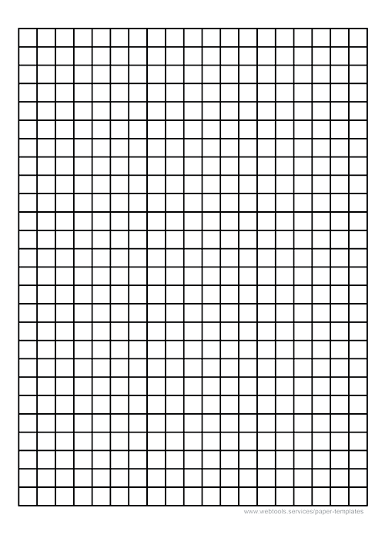
I: Worked example
Find the resultant vector of an object that travels 100 N right and 80 N down.
39◦
Suitable scale: 1cm = 20N
6.4cm
6.4 cm = 20 x6.4 = 128N
Angle from the first vector = 39◦
Notes:
Always follow these steps:
The resultant of two (or more) vectors acting perpendicular to each other can be determined using a scale drawing.
Choose a suitable scale to use for the scale drawing (e.g. 1 N = 1 cm)
Draw the first vector using your scale and a ruler
Draw the second vector using the same scale
Draw a dotted line from the point of origin to the opposite corner - this is the resultant vector
Measure the length of the resultant and use your scale to determine its real magnitude
Measure the angle between the first vector and the resultant using a protractor

Slide 17
We: Worked example
Find the resultant vector of an object that travels 9N up and 3N left.
Suitable scale: 1cm = 1N
9.5 cm = 1 x9.5 = 9.5N
Angle from the first vector = 18°
9.5cm
18°
Notes:
Always follow these steps:
The resultant of two (or more) vectors acting perpendicular to each other can be determined using a scale drawing.
Choose a suitable scale to use for the scale drawing (e.g. 1 N = 1 cm)
Draw the first vector using your scale and a ruler
Draw the second vector using the same scale
Draw a dotted line from the point of origin to the opposite corner - this is the resultant vector
Measure the length of the resultant and use your scale to determine its real magnitude
Measure the angle between the first vector and the resultant using a protractor

Slide 18
You: Worked example
Find the resultant vector of an object that travels 15 m East and 25 m North.
Suitable scale: 1cm = 5m
5.8 cm = 1 x5.8 = 29m
Angle from the first vector = 59°
5.8cm
59°
Notes:
Always follow these steps:
The resultant of two (or more) vectors acting perpendicular to each other can be determined using a scale drawing.
Choose a suitable scale to use for the scale drawing (e.g. 1 N = 1 cm)
Draw the first vector using your scale and a ruler
Draw the second vector using the same scale
Draw a line from the point of origin to the opposite corner - this is the resultant vector
Measure the length of the resultant and use your scale to determine its real magnitude
Measure the angle between the first vector and the resultant using a protractor

Slide 19
Minimum and Maximum Resultants
Think outside the box!
How could two vectors combine to make the largest possible resultant vector (the maximum)?
How could two vectors combine to make the largest possible resultant vector (the maximum)?
Should the vectors act at 0º, 90º or 180º to each other?
Notes:
This can be used as an additional activity to get pupils thinking about the direction of actions of different pairs of vectors and the possible results.
Pupils should be able to explain that vectors acting in the same direction are added and in opposite directions are subtracted but thinking of it in terms of angles adds another level of challenge to think about.
Vectors acting at 0º to each other - the angle between them is 0º so they must be pointing/acting in the same direction
Same direction so vectors would be added together - this would be the maximum resultant vector.
Vectors acting at 180º to each other would be in opposite directions and would be subtracted - giving the minimum resultant vector.
If they were acting at 90º to each other the resultant would be larger than each of the single vectors but it could never be greater than if they were added together.
You may want to demonstrate this using numbers.
Suggested guidance:
Talk tasks can be used in a variety of ways to suit the particular needs of the students you are teaching. Through exchanging views with others, students develop their understanding of the science beyond what could be achieved individually.
Science classrooms that successfully integrate talk have the following features:
Science talk is a regular feature of lessons and is woven into classroom activities.
Students are paired or grouped strategically by the teacher to ensure productive interaction. This might take into consideration the students’ proficiency of the English language, how encouraging they might be to peers and their attainment in the topic. It’s a good idea to consider these pairings in the class seating plan.
Students are encouraged and supported to talk, but are not forced to talk.
The teacher should take on the role of a facilitator, engaging with conversations where necessary and encouraging or steering the conversation where needed.
Students are encouraged to use the language they have to express their ideas (e.g., everyday language, imperfect English, native language), but also to incorporate science specific terminology where this is more accurate or has been taught.
6. Scientifically inaccurate ideas are not dismissed by the partner or teacher; open discussion and further investigation are relied on to help students construct ideas that support them to progress in their scientific understanding.
7. Guidelines for behaviour during talk tasks are explicit and frequently reviewed. Rules for students might be:
Listen carefully to your partner
Take turns talking.
Speak one at a time, without interrupting.
Politely agree or disagree and explain why.
Politely point out if your partner has used a scientific word incorrectly, if they have explained the science incorrectly, or if there is a more accurate way to describe something.
If confused, ask questions.
Stay focused on the discussion topic.
Respond to one another.

Slide 20
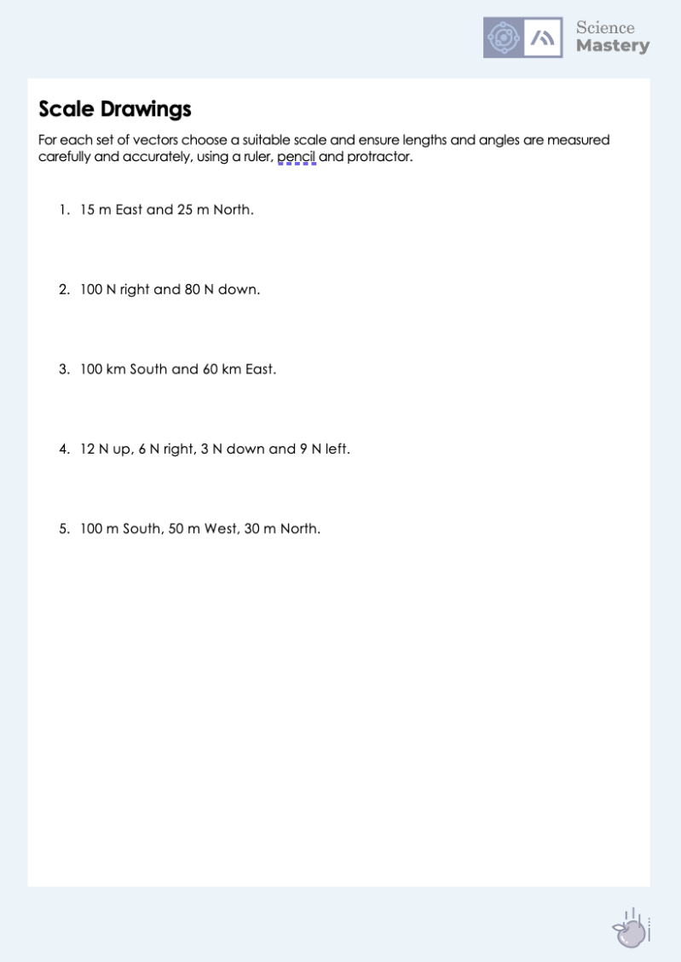
Resultant Vectors
Complete the scale drawing activity.
Make sure you state your scale and use a ruler and pencil.
Notes:
Purpose: practice application of new knowledge.
Mark scheme included for scale drawings using stated scale – it may be useful to draw up your own if you use/give pupils a different scale. Pupils can measure angles for direction and then report as bearing or with reference to compass points, but this is a very advanced skill.
Stretch suggestion for pupils – give pupils two diagonal vectors acting on the same object so they first have to resolve the components before simplifying horizontal and vertical components and finding the overall resultant.

Slide 21
Answer the questions below.
1. Which is the best definition of resultant vector?
A. A vector that has the same effect as two or more single vectors
B. The net force acting on an object
C. A quantity that has both size and direction
2. A diagonal resultant vector of magnitude 12 N could be made up of…
A. Two horizontal 6 N components
B. A horizontal 18 N and a horizontal 6 N component
C. Two 8.5 N components
3. Which is an essential aspect to include in a scale drawing?
A. Lines drawn in pen
B. A scale
C. A bearing
✓
✓
✓
Notes:
Suggested Guidance:
Q1. Answer: A
If students answer B, they have confused resultant force and resultant vector, which is the broader class of quantities. If students answer C, they have confused vector and resultant vector. To fix-it, pupils could write the definition of each and explain why they are not the same.
Q2. Answer: C
If students answer A or B, they are not clear on how a diagonal vector is produced from horizontal and vertical components. To fix-it, it may be useful to go through the different scenarios with vectors being combined and show them this working mathematically – i.e. two vectors acting in the same direction will produce the maximum resultant vector, two acting in opposite directions would produce the minimum vector.
Q3. Answer: B
If students answer A or C, they have not understood the key aspect of a scale drawing. To fix-it, they could use further practice drawing scale drawings (in pencil) and a further explanation that a bearing is not necessarily required if pupils have described the direction of the resultant vector with an angle already.

Slide 22
Lesson P3.1.3
What was good about this lesson? | What can we do to improve this lesson?
Send us your feedback by clicking this link
or by emailing sciencemastery@arkonline.org
Thank you!

